Slide 1
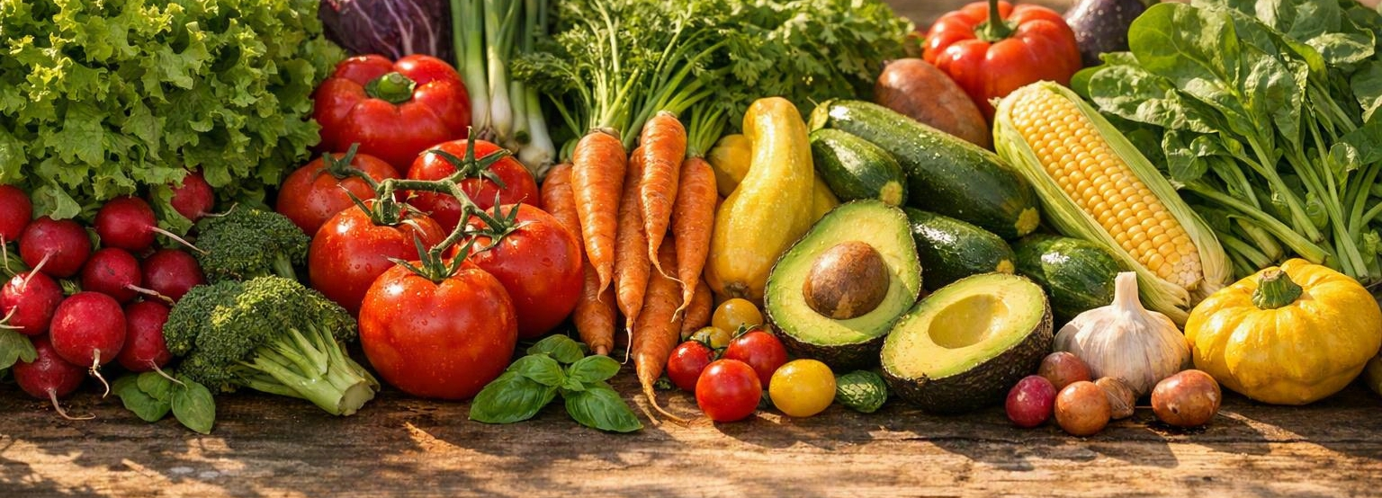
Local. Sustainable. FRESH
By Uzair Ali

Slide 2
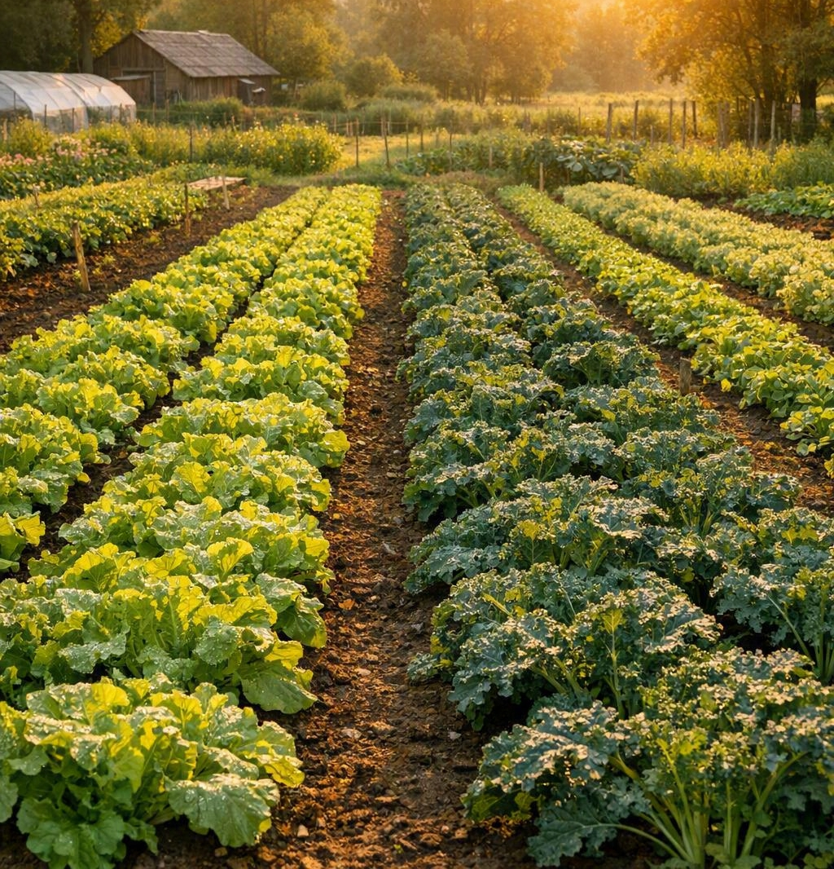
Connecting Identity with Social Purpose
Core Brand Representation: Honoring your commitment to local farming, reduced food miles, and ecological sustainability.
Campaign Objective: Drive target audience conversions to FreshFareFarms.meals/signup during Hunger Action Month.
Community Impact: Every signup directly triggers a donated box of fresh produce to local community food banks.
Notes:
When looking at how each design represents your brand, we anchored everything in your mission to provide nutritious, sustainably grown food. The primary campaign objectives were clear: generate conversions while celebrating your social impact initiative. We aligned our copy directly to your goals, making sure every asset explicitly communicates that signing up during Hunger Action Month triggers a crucial produce donation to local food banks. This transforms a simple service sign-up into an act of community solidarity

Slide 3
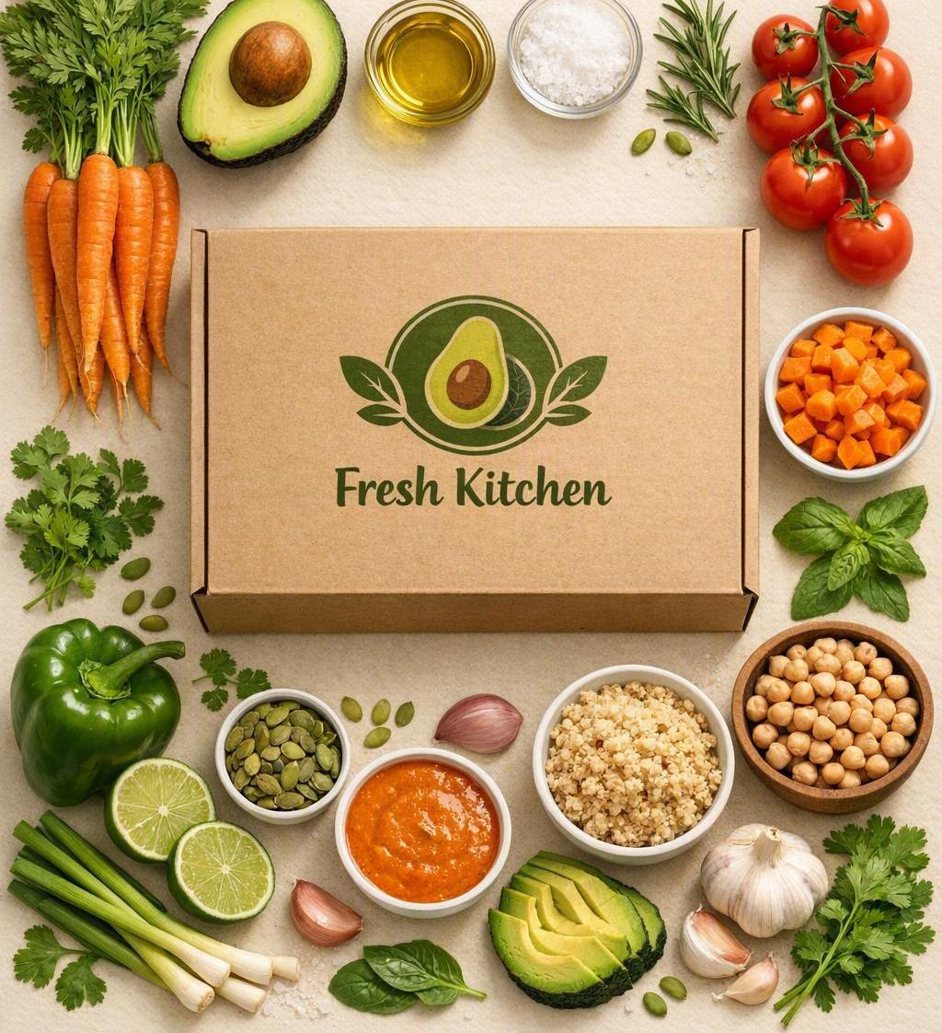
One Cohesive Campaign Voice
Unified Campaign Tagline: "Local. Sustainable. FRESH."
Strict Palette Adherence: Visual layouts anchored in Avocado Green (#789b4a), Lime Green (#e0e568), and Carrot Orange (#f57f45).
Consistent Typography Hierarchy: Filmotype LaSalle for emotional, high-impact headlines; Futura PT for structured body text.
Notes:
To build strong brand equity, we applied rigorous consistency across all deliverables to establish an immediate, cohesive identity. Whether a potential customer sees your full-page magazine spread, scrolls past a web banner, or swipes through an Instagram carousel, they will experience a unified message. We utilized the exact same primary font pairing—Filmotype LaSalle for our expressive, high-impact headers and Futura PT for our clear, clean body blocks. Furthermore, we integrated your exact brand palette, leaning on organic shape blocks and structured layouts to connect the channels flawlessly

Slide 4

Engaging Health-Conscious Consumers
Visual Preferences: Clean, premium, transparent, and imagery-heavy layouts tailored for Gen Z and Millennials.
Delivering the Message: Visually connecting healthy meal convenience with immediate community action.
Highlighting the CTA: Using high-contrast Carrot Orange shapes and bold typography to draw immediate focus to your signup destination.
Notes:
We intentionally designed these assets with your target demographic of younger, health-conscious Gen Z and Millennial audiences in mind. These consumers value aesthetic clarity, transparency, and structural, imagery-heavy layouts. The photography tells an authentic story of fresh ingredients, home-cooked meals, and active community volunteering. To guarantee high conversions, we highlighted your call to action by placing it inside vibrant, high-contrast Carrot Orange shapes. By pairing a bold CTA with an exclamation point and changing the copy to Futura PT Bold, we give the audience a distinct, visually clear path to action.

Slide 5
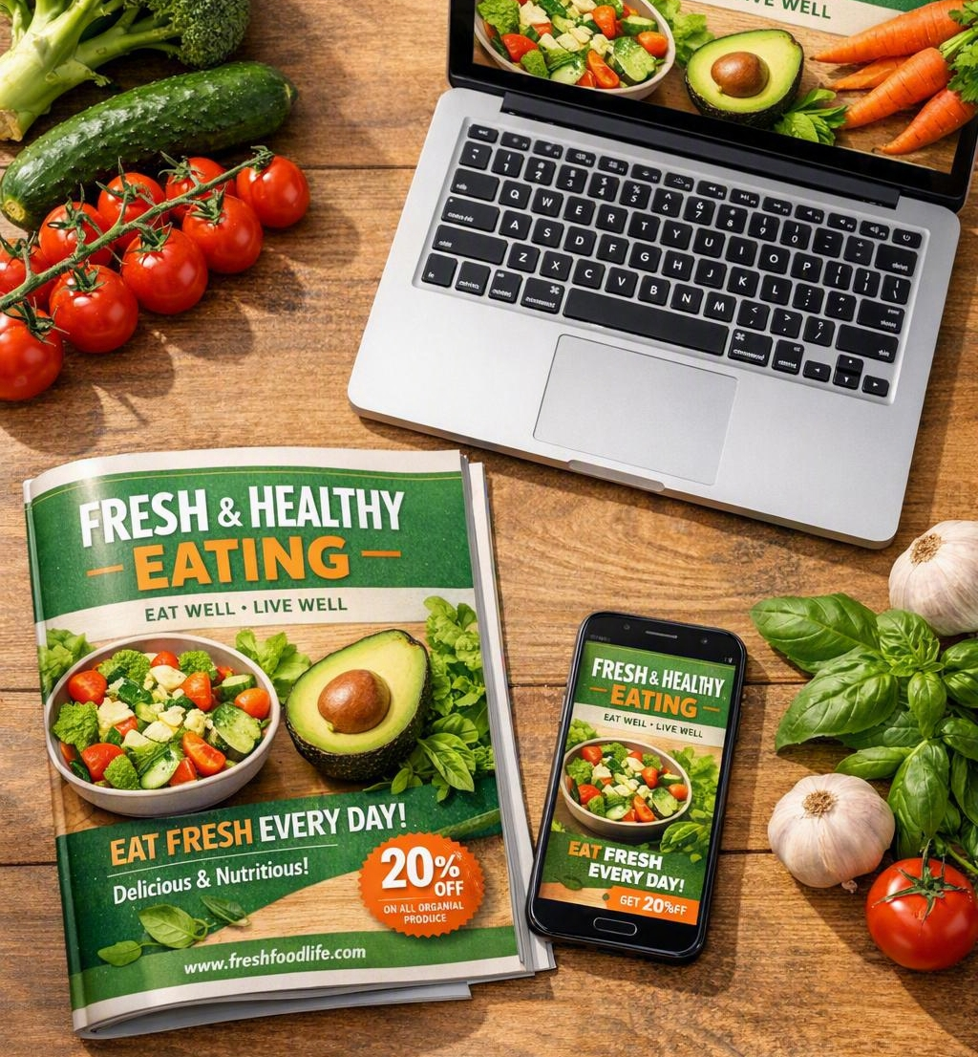
Designing for Three Distinct Canvases
Print Magazine (8.625 X 10.75 in): Expansive, high-resolution storytelling (300 DPI / CMYK); challenged by static space boundaries.
Digital Leaderboard (728 X90): Exceptional cross-web visibility; severely restricted by tight horizontal spatial constraints.
Social Media Carousel (1080 X1080): Interactive sequential frame building (1:1 Web Canvas); requires compressing text into punchy captions.
Notes:
Adapting our design across different mediums forced us to carefully evaluate technical specifications. Working in print allowed us to expand on your story using rich, high-resolution imagery and a comprehensive narrative block. The advantage here is premium real estate, though the challenge is its static nature. Conversely, when translating this into the digital leaderboard space, we faced severe vertical constraints. The challenge was keeping the copy punchy and readable at low web resolutions. For our social carousel, we embraced a square aspect ratio. This gave us an incredible storytelling advantage across sequential frames, allowing us to break up information into digestible, interactive beats.

Slide 6
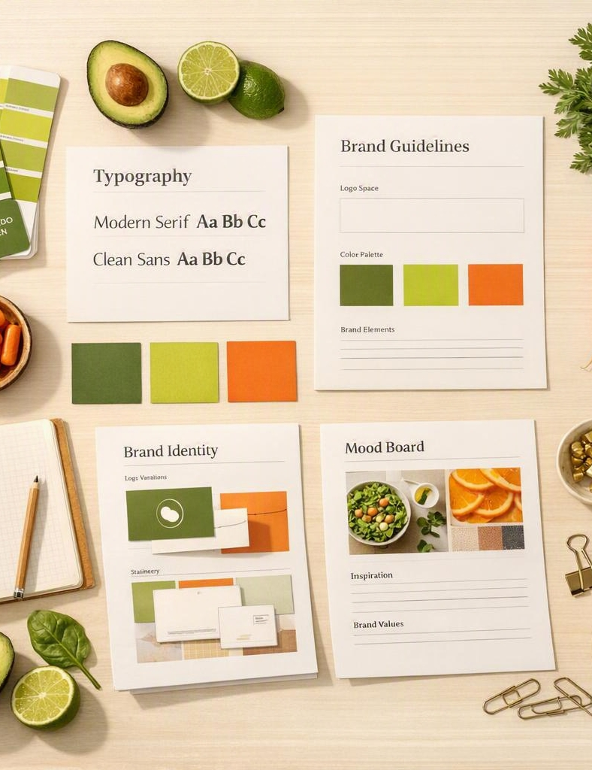
Strategic Refinements & Brand Purity
Text Hierarchy Overhaul: Streamlining dense text paragraphs down to immediate, action-oriented digital copy callouts.
Typography Optimization: Shifting prominent screen copy from Futura PT Book to Futura PT Bold for optimized digital readability.
Absolute Brand Alignment: Eliminating all instances of unapproved pure black text, replacing them completely with approved brand dark palette colors.
Notes:
Naturally, moving across these distinct mediums required deliberate design compromises. We could not simply paste our comprehensive magazine layout onto a digital leaderboard. We had to heavily streamline our body copy for digital screens, extracting only the most punchy, action-oriented lines. Furthermore, in incorporating critical creative feedback, we audited our digital files to remove all instances of unapproved pure black text, replacing them with rich colors from your approved palette. We shifted our digital messaging to Futura PT Bold for increased legibility on screens and eliminated duplicate text layers to ensure your layouts remain clean, minimal, and impactful.

Slide 7
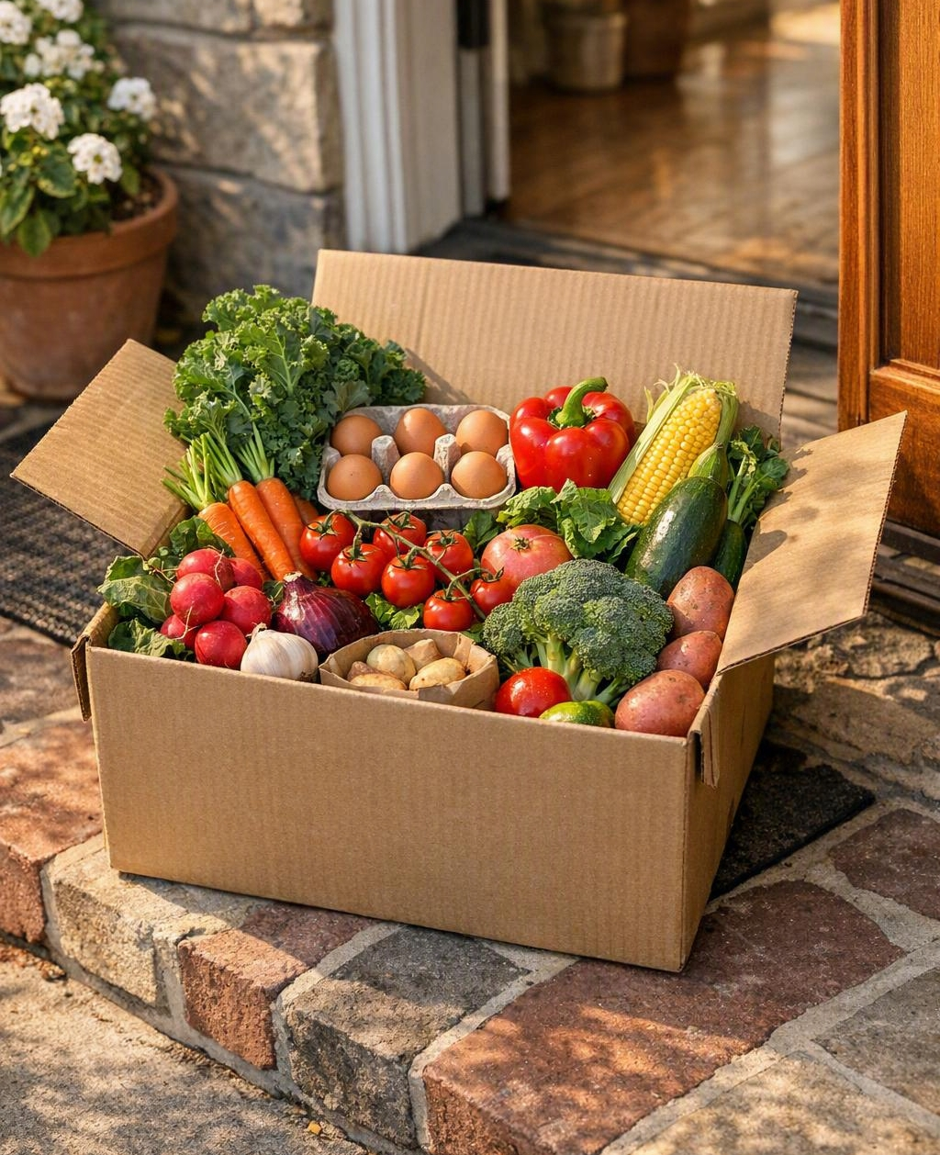
The Artistic Elements of Engagement
Organic Shapes: Implementing soft-edged, rounded geometric containers to mimic natural, organic farming structures.
Human Connections: Selecting imagery centered on authentic human interactions, community outreach, and natural farm harvesting.
Transparent Sourcing: Full image asset compliance tracked, verified, and logged in our GRA 415 Attribution Tracking Spreadsheet.
Notes:
Finally, let's look at why we selected these specific design elements and visual imagery. We utilized organic, soft-curved color blocks and framing boundaries to mimic the natural, imperfect edges of fresh farm produce. The imagery was carefully selected to avoid sterile, overly staged stock photography. Instead, we prioritized authentic, warm-toned human moments—showing friends cooking together, real agricultural harvesting, and direct, tangible local delivery boxes. Every single image used has been rigorously logged with full creative rights in our tracking spreadsheet. This intentional balance of clean structural lines, open whitespace, and rich lifestyle photography tells an emotional story that makes your target audience proud to support your brand.

Slide 8
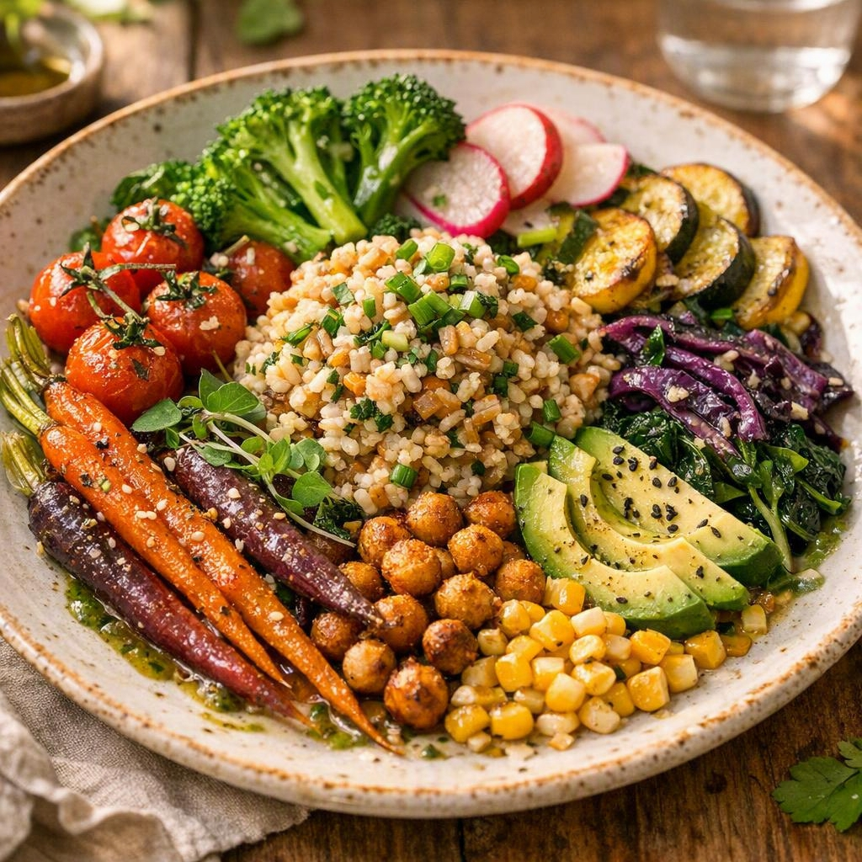
Keep Your Community FRESH!
Campaign assets completely optimized for print production and digital deployment.
Primary Landing Destination: www.FreshFareFarms.meals/signup
Thank you for your partnership! Open for Agency-Client Discussion
Notes:
With these unified assets, our agency is confident that Fresh Fare Farms will launch a highly effective, visually stunning, and deeply responsible campaign this Hunger Action Month. We are ready to move these files directly into production. Thank you so much for your time today, and we would love to open up the floor to hear your thoughts and answer any questions you may have!

